Slide 1


Sentiment Analysis Project
on Amazon Product Reviews
Innovators Team
Presented By:
Ahmed Mohamed Essam
Omar Tamer Salah El Din
Mostafa Mohamed Amin
Ahmed Tarek El Sayed Ghazy

Slide 2
Project Responsibilities
Mostafa Mohamed Amin : Exploratory Data Analysis (EDA)
Ahmed Tarek El Sayed Ghazy : Machine Learning and Data Preprocessing for Text Classification
Omar Tamer Salah El Din : Advanced Techniques for Text Classification
Ahmed Mohamed Essam : Azure Deployment and MLflow

Slide 3
Exploratory Data Analysis (EDA)

Slide 4
Data Origin
Dataset Source: Amazon product reviews (spanning 18 years)
Total Reviews: ~35 million reviews up to March 2013
Data Components: Product & user information, ratings, plaintext reviews
Reference: Paper by J. McAuley and J. Leskovec (RecSys, 2013)

Slide 5
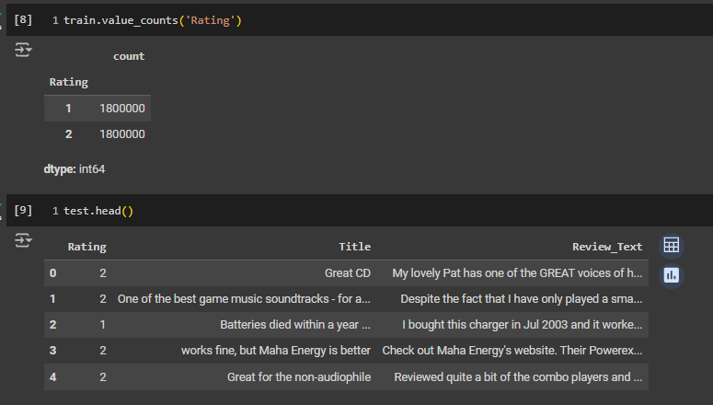
Data Overview
Polarity Definition
Negative: 1-2 stars
Positive: 4-5 stars
Neutral reviews (3 stars) were ignored
Dataset Breakdown
1,800,000 training samples per class
200,000 testing samples per class
Key Columns
Polarity, Review Title, Review Text

Slide 6
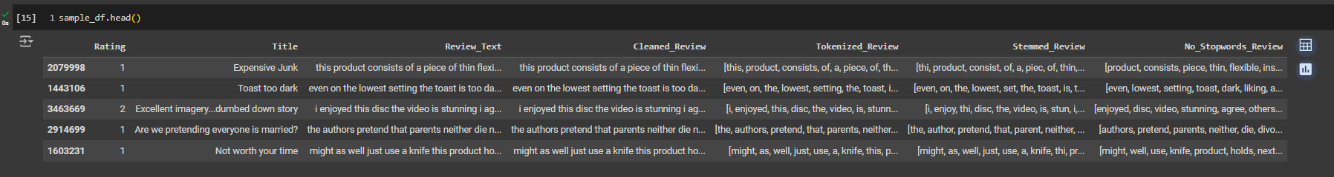
Data Cleaning & Preprocessing
Steps Taken
No missing values were found
Text preprocessing: cleaning, tokenization, and normalization
Additional preprocessing: stop word removal, lemmatization
Outcome
Cleaned text ready for sentiment analysis

Slide 7
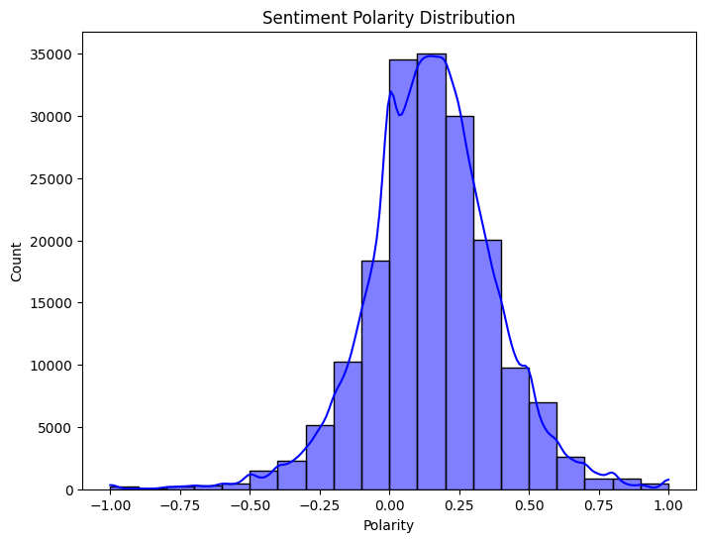
Basic Statistical Summary
Key Metrics
Mean Rating: Indicates overall satisfaction
Median Rating: Helps understand data skewness
Mode Rating: Shows most common rating
Insight
Most ratings are consistent, indicating satisfaction

Slide 8
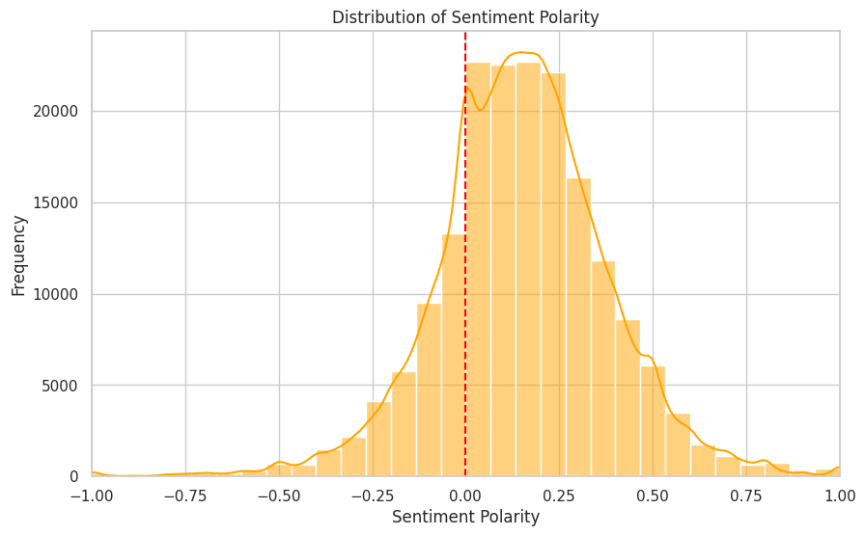
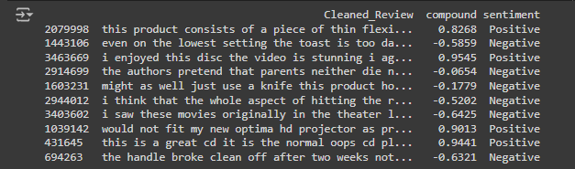
Sentiment Analysis &Review trend overtime
VADER Sentiment Model
Calculates positive, negative, neutral, and compound sentiment scores
Compound score used to classify reviews as Positive, Neutral, or Negative
Outcome
Reviews categorized by sentiment for further analysis

Slide 9
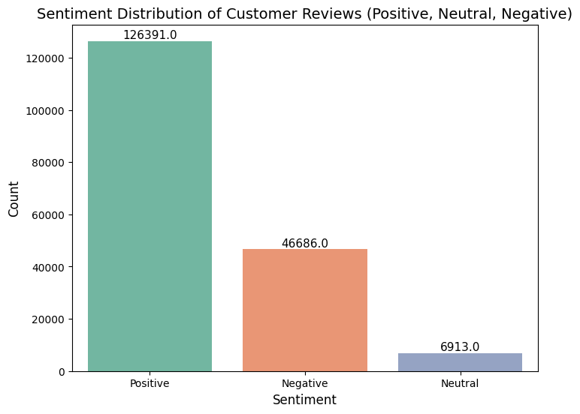
Sentiment Distribution
Key Findings
Positive Sentiment: 1,421 reviews
Neutral Sentiment: 54 reviews
Negative Sentiment: 122 reviews
Insight
The majority of reviews were positive, suggesting customer satisfaction

Slide 10
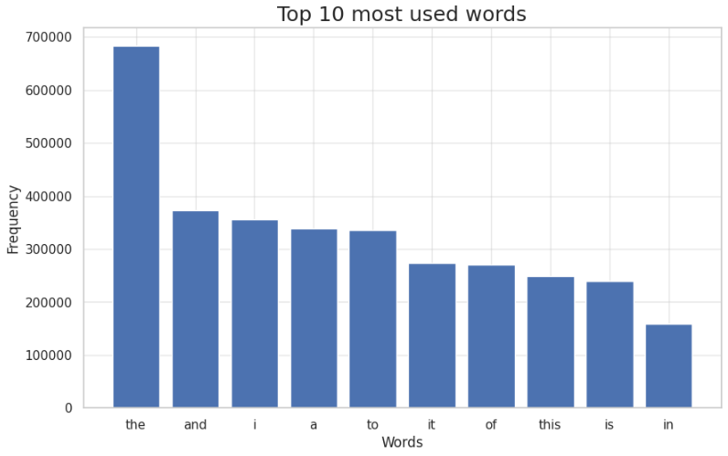
Word Count and Length Analysis
Analysis
Added word count and character count columns
Insight
Longer reviews often indicated more extreme sentiments

Slide 11
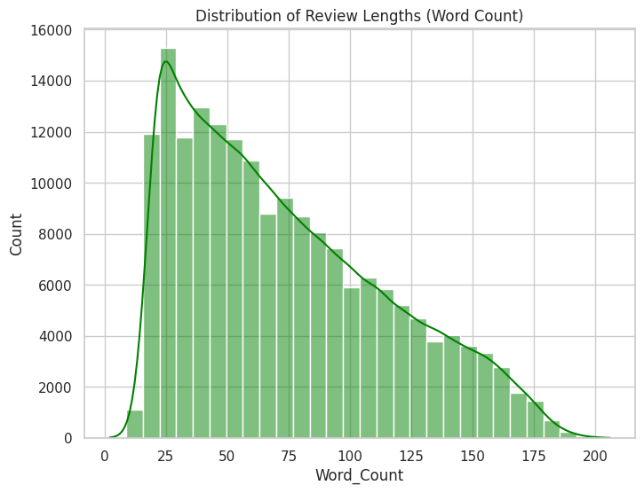
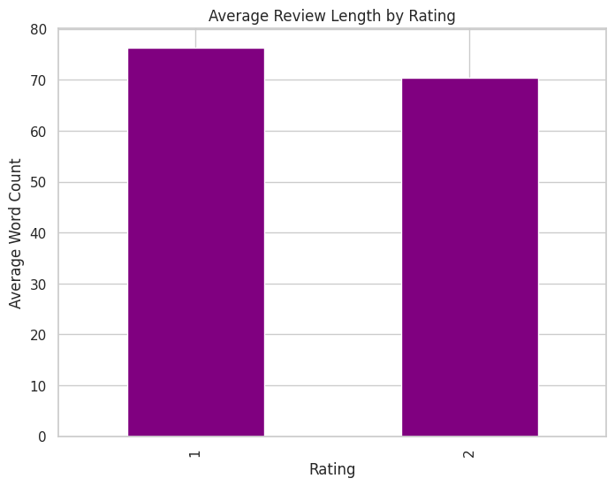
Word Count and Length Analysis (Contd.)

Slide 12
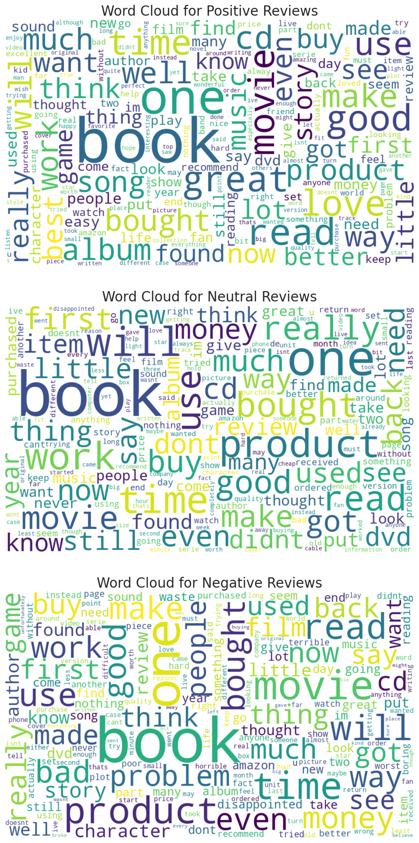
Word Cloud Visualization
Word Cloud
Highlights most frequent words used in reviews
Insight
Common themes like "quality," "love," or "bad" reveal product-focused feedback

Slide 13
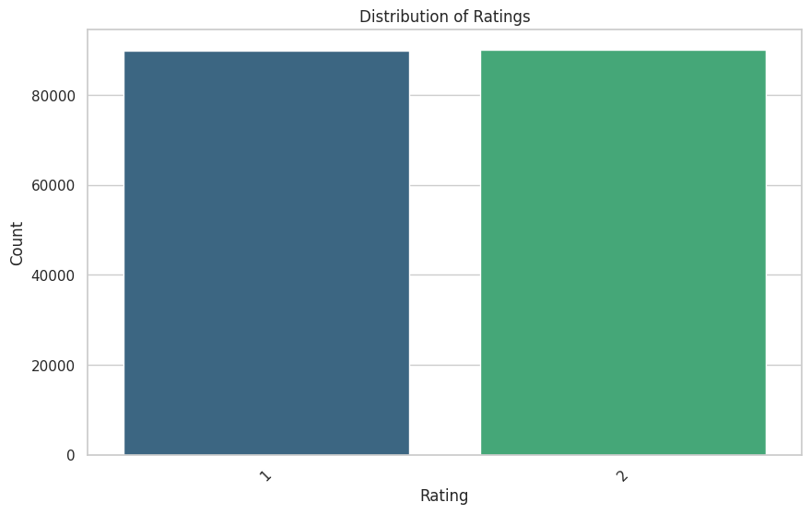
Rating Distribution
Visualization
Histogram showing polarized rating distribution (1-star or 5-star)
Insight
Customers either loved or disliked products intensely

Slide 14
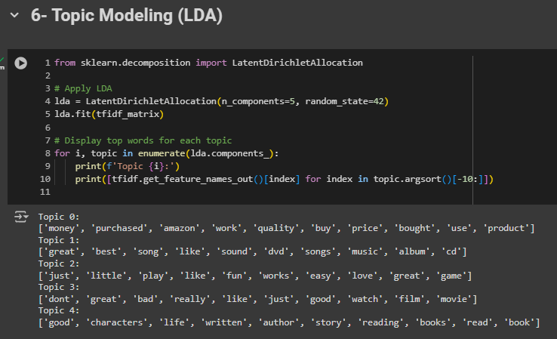
Topic Modeling (LDA)
Technique Used: Latent Dirichlet Allocation (LDA) for topic modeling
Steps:
Applied LDA on the cleaned review texts to extract latent topics.
Number of Topics: [Specify number based on analysis]
Keywords were identified for each topic.
Outcome:
The most common topics discussed in reviews were identified, helping understand key themes.
Example Topics:
Topic 1: Shipping & Delivery Issues (keywords: "late," "shipping," "package")
Topic 2: Product Quality (keywords: "quality," "durable," "defective")
Topic 3: Customer Service (keywords: "support," "helpful," "return")

Slide 15
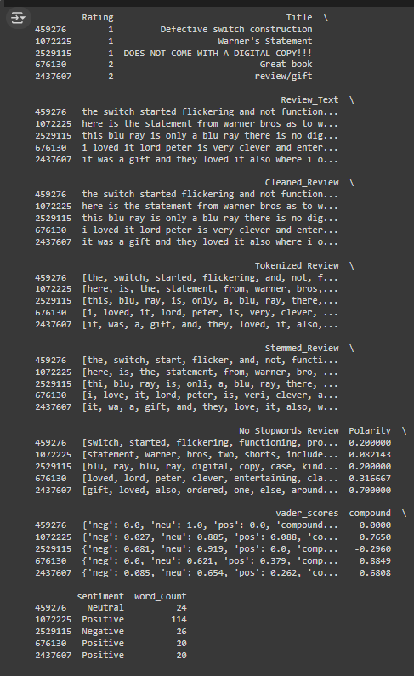
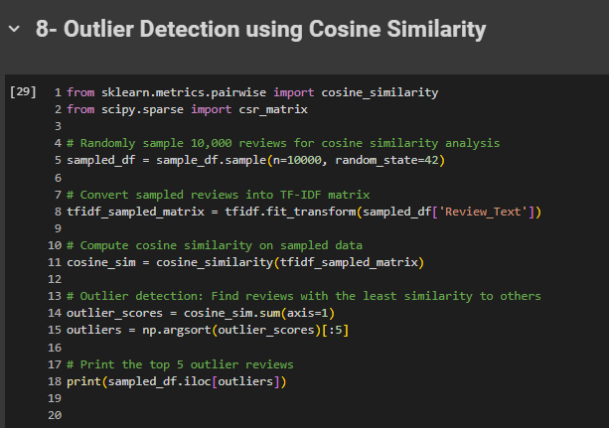
Outlier Detection (Cosine Similarity)
Method
Used cosine similarity to detect unique, outlier reviews
Insight
Outliers represent exceptional customer experiences, useful for identifying special cases

Slide 16
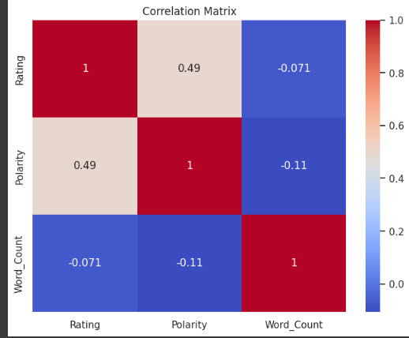
Correlation Matrix
Correlated Features
Rating vs. Polarity (strong correlation)
Word count vs. Rating (weak correlation)
Insight
Sentiment scores strongly align with customer ratings

Slide 17
Summary of EDA
Overall Sentiment: Majority of reviews are positive
Ratings Polarization: Reviews polarized between 1-star and 5-star
Common Themes: Frequently mentioned words in reviews
Outliers: Unique insights from rare customer experiences
Key Topics Identified: LDA extracted latent topics, revealing patterns in customer feedback (e.g., product quality, shipping issues)
Correlations: Strong link between ratings and sentiment

Slide 18
Machine Learning and Data Preprocessing for Text Classification

Slide 19
Data Preprocessing
Start
Data Loading
Resampling
Text Cleaning and Lemmatization
Tokenization
Feature Engineering
End

Slide 20
Data Preprocessing
Cleaning Text: Removing special characters, converting to lowercase, removing punctuation, and URLs.
Removing Stop Words: Filtering out common words that do not contribute to the meaning.
Lemmatization: Reducing words to their base or root form.

Slide 21
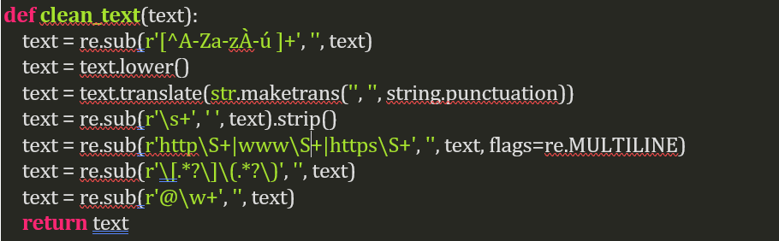
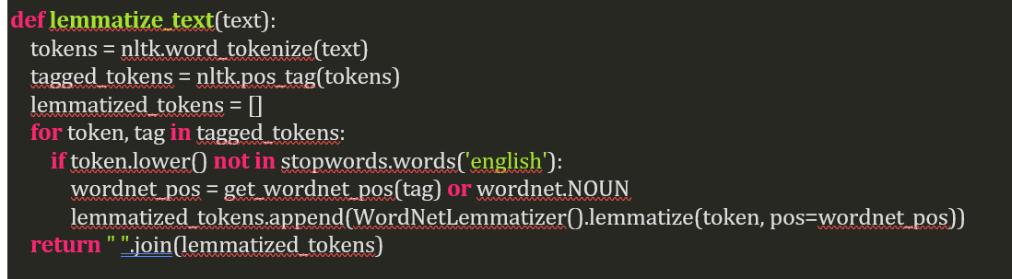
Code Snippet

Slide 22
Feature Engineering with TF-IDF
TF-IDF (Term Frequency-Inverse Document Frequency):
Converts text data into numerical features suitable for machine learning models.
Captures the importance of words in the context of the document and the entire dataset.
TF(machine, Document 1) = (Number of times 'machine' appears) / (Total number of words in Document 1) = 2 / 7 = 0.2857
IDF(machine) = log_e(Total number of documents / Number of documents containing 'machine’) = log_e(2 / 2) = 0
TF-IDF(machine, Document 1) = TF(machine, Document 1) * IDF(machine) = 0.2857 * 0 = 0
Text document
Document 1: "Machine learning is fascinating. Machine learning is powerful.“ Document 2: "Deep learning is a subset of machine learning."
Term Frequency (TF)
Inverse Document Frequency (IDF)
TF-IDF Calculation

Slide 23
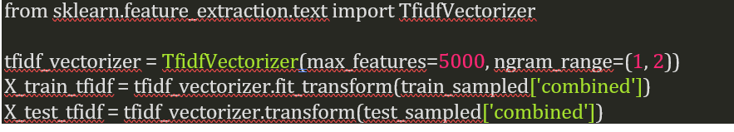
Code Snippet

Slide 24
Model Training and Evaluation
Models Tested
Logistic Regression, SVM, Random Forest, Gradient Boosting, Ensemble Methods.
Best Model - SVM
Performance: Higher accuracy and better classification metrics.
Hyperparameter Tuning: Optimized using GridSearchCV.
Handling Non-linearity: RBF kernel handles non-linear relationships effectively.

Slide 25
Model Training and Evaluation
Model | Accuracy | Precision | Recall | F1-Score
Logistic Regression | 85% | 0.85 | 0.85 | 0.85
SVM | 86% | 0.86 | 0.86 | 0.86
Random Forest | 83% | 0.83 | 0.83 | 0.83
Gradient Boosting | 79% | 0.79 | 0.79 | 0.79
AdaBoost | 81% | 0.81 | 0.81 | 0.81
Extra Trees | 84% | 0.84 | 0.84 | 0.84
XGBoost | 82% | 0.82 | 0.82 | 0.82
CatBoost | 82% | 0.82 | 0.82 | 0.82
Multinomial Naive Bayes | 83% | 0.83 | 0.83 | 0.83
Voting Classifier | 84% | 0.84 | 0.84 | 0.84

Slide 26
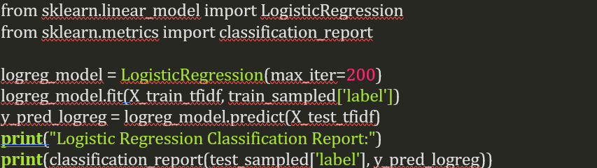
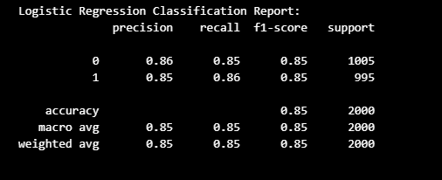
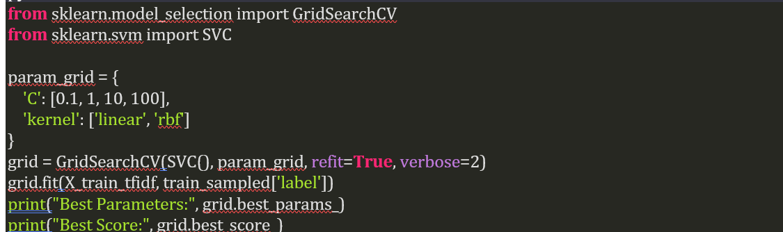
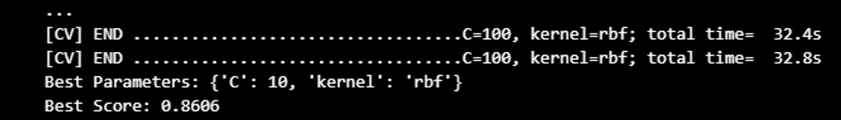
Code Snippet

Slide 27
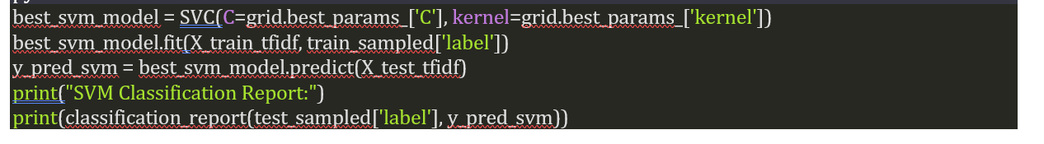
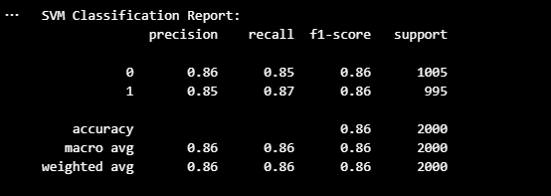
Code Snippet

Slide 28
Visualization and Conclusion
Visualization
Confusion Matrix: Shows the performance of the SVM model.
Word Cloud: Highlights the most frequent words in the positive class.
Conclusion
SVM outperformed other models due to its ability to handle high-dimensional, sparse data, margin maximization, and effective regularization.
The project demonstrates a comprehensive approach to text classification using machine learning.

Slide 29
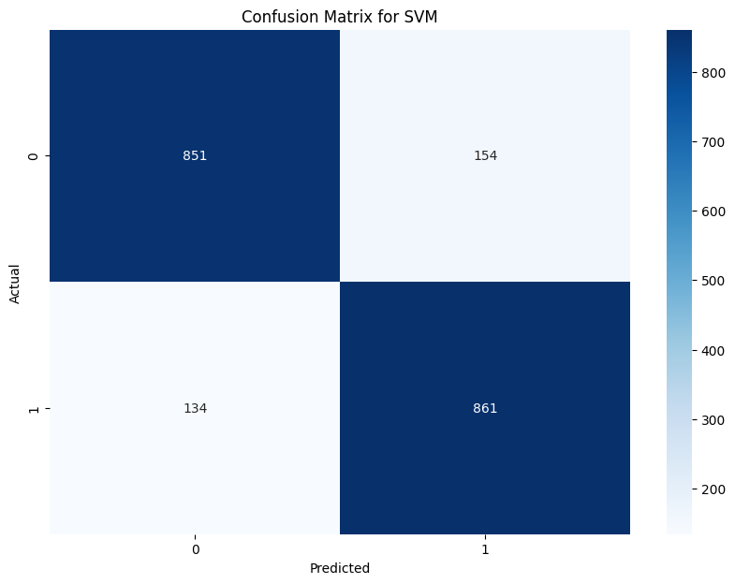
Visualization and Conclusion

Slide 30
Advanced Techniques for Text Classification

Slide 31
RNN Challenges in Text Processing
Sequential Nature
Processes data sequentially.
Slow especially with long sequences.
Can’t parallelize computations.
Vanishing/Exploding Gradients
Struggles with long-term dependencies.
Gradient issues.
Hard to capture contextual information across long texts.

Slide 32
RNN Challenges in Text Processing
Limited Context
Considers primarily past context.
Limited understanding of complex relationships within text.
Struggles with future context.
Memory Inefficiency
Requires more memory to process long text.
Also requires more computing power.

Slide 33
Transformers - Revolutionizing Text Processing
Parallelization
Process all tokens simultaneously, unlike RNN.
Speed up training and inference.
Self-Attention Mechanism
Focus on relevant parts of the input sequence.
Capture long-range dependencies effectively.

Slide 34
Transformers - Revolutionizing Text Processing
Scalability
Parallel processing.
Handle larger datasets more efficiently.
Also handle longer sequences.
Better Contextual Understanding
Consider both past and future context in a sentence.
Enhance understanding and accuracy.

Slide 35
Understanding BERT
Bidirectional Contextualization
BERT = Bidirectional Encoder Representations from Transformers.
Reads text bidirectional considering the context from both directions.
Highly effective for understanding language.
Pre-trained on Large Corpora
Pre-trained on massive amounts of text data.
Captures a vast array of language patterns and nuances.

Slide 36
Understanding BERT
Transfer Learning
Quick fine-tuning on specific tasks.
Adaptable and efficient.

Slide 37
DistilBERT - Efficient and Powerful
Lightweight Version of BERT
Retains 97% of BERT’s performance.
60% faster, 40% less memory.
Suitable for real-time applications.
Knowledge Distillation
Trained using a knowledge distillation process.
Compresses BERT’s capabilities into a smaller & faster model.
No significant loss in accuracy.

Slide 38
DistilBERT - Efficient and Powerful
Faster Inference
Ideal for applications where speed and efficiency are crucial.
Real-time sentiment analysis.
Reduced Resource Requirements
More computationally efficient.
Easier to deploy and scale.

Slide 39
DistilBERT Architecture
Simplified Transformer Layers
Fewer transformer layers than BERT (6 instead of 12) with same model size.
More efficient.
Reduced Resource Requirements
Uses self-attention to understand contextual relationships in text.
Faster processing.

Slide 40
DistilBERT Architecture
Large Scale Corpus Training Dataset
Trained on the same datasets as BERT (e.g. Wikipedia and BookCorpus dataset).
Capture general language patterns and semantics.
General-Purpose Model
Fine tuned for various tasks, such as text classification & sentiment analysis.

Slide 41
Azure Deployment

Slide 42
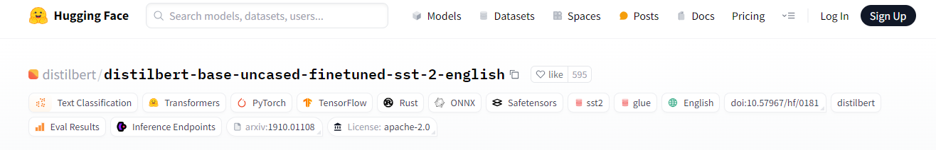
Hugging Face - DistilBERT SST2 Model

Slide 43
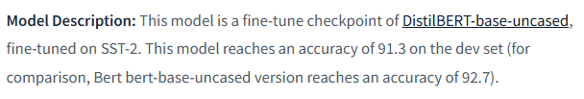
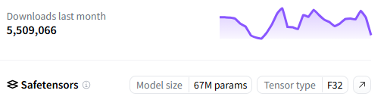
Hugging Face - DistilBERT SST2 Model

Slide 44
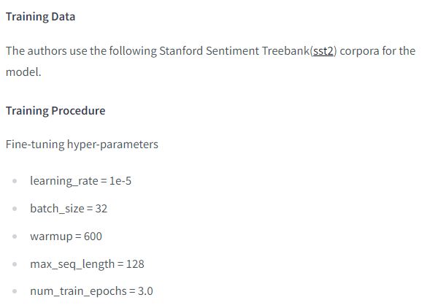
Hugging Face - DistilBERT SST2 Model

Slide 45
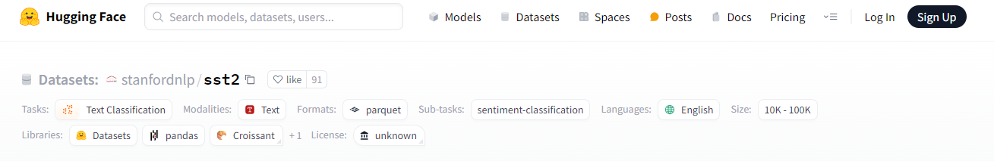
Hugging Face - SST2 Dataset

Slide 46
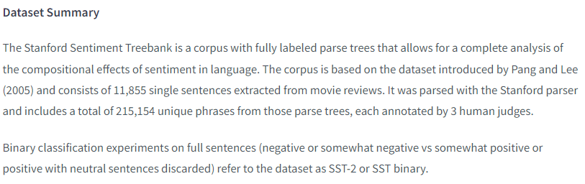
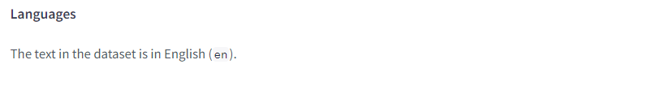
Hugging Face - SST2 Dataset

Slide 47
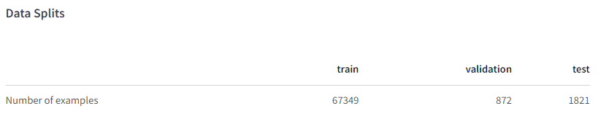
Hugging Face - SST2 Dataset

Slide 48
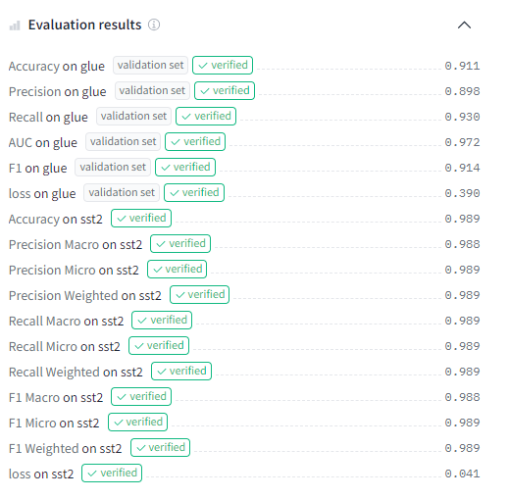
Hugging Face - DistilBERT SST2 Model

Slide 49
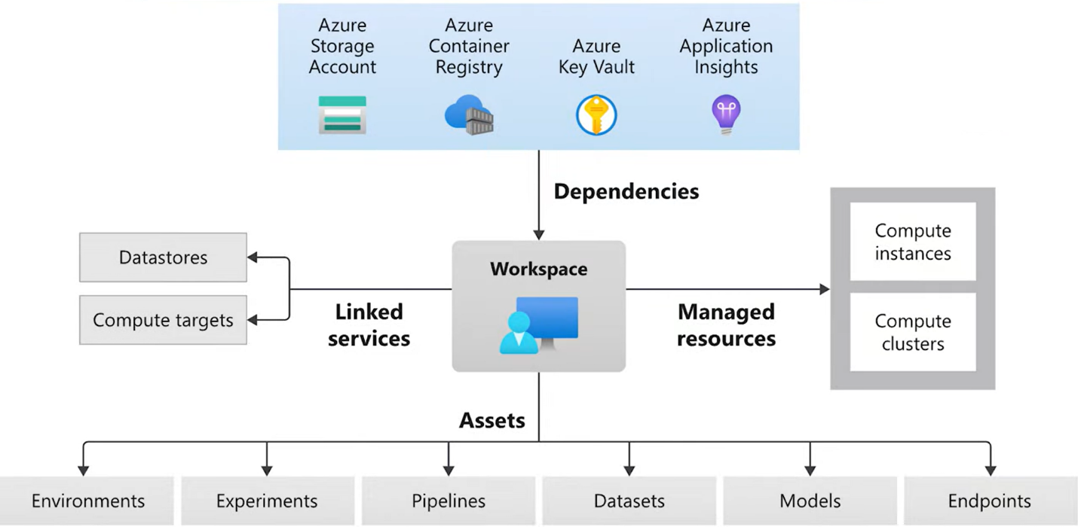
Azure Machine Learning Studio

Slide 50
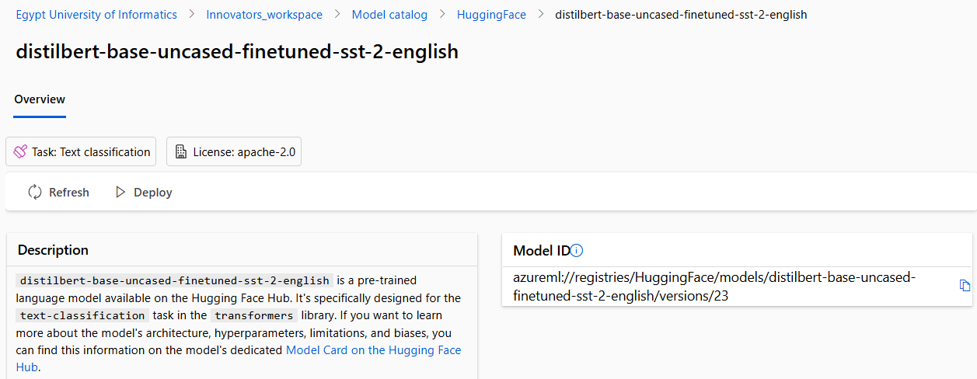
Model Catalog

Slide 51
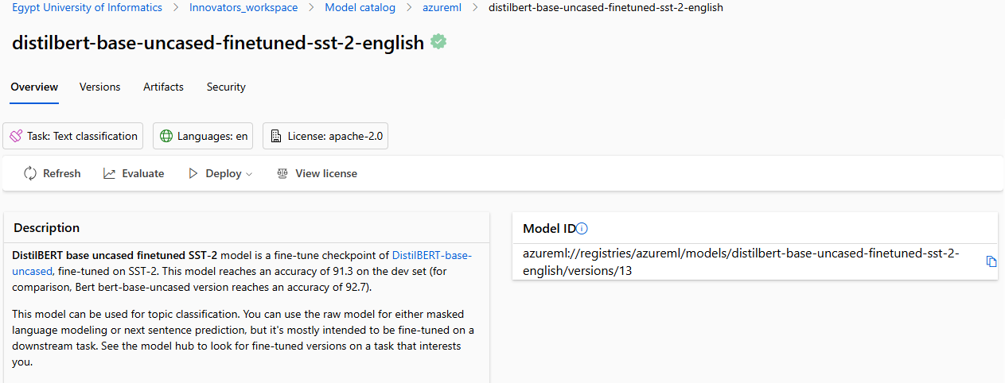
Model Catalog

Slide 52
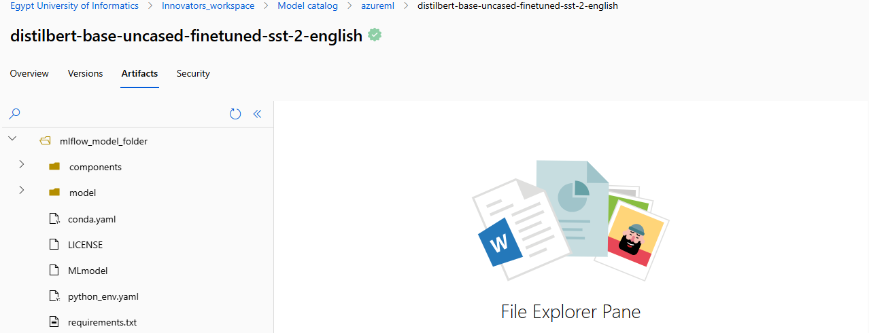
Artifacts

Slide 53
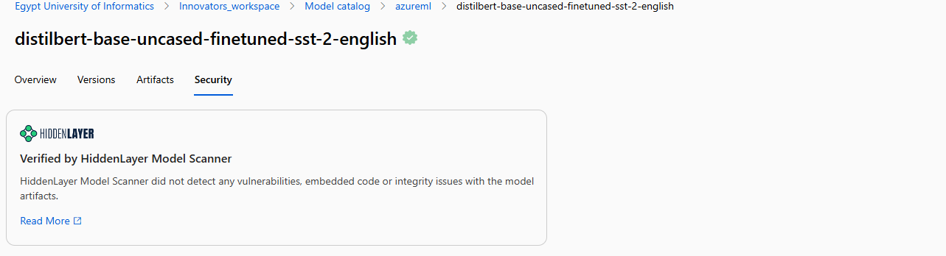
Security

Slide 54
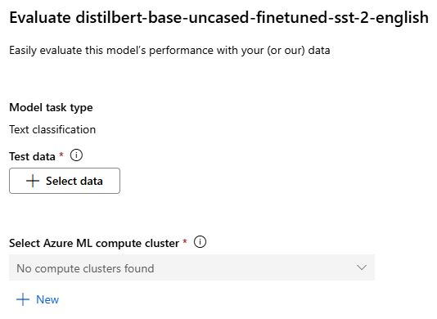
Evaluation

Slide 55
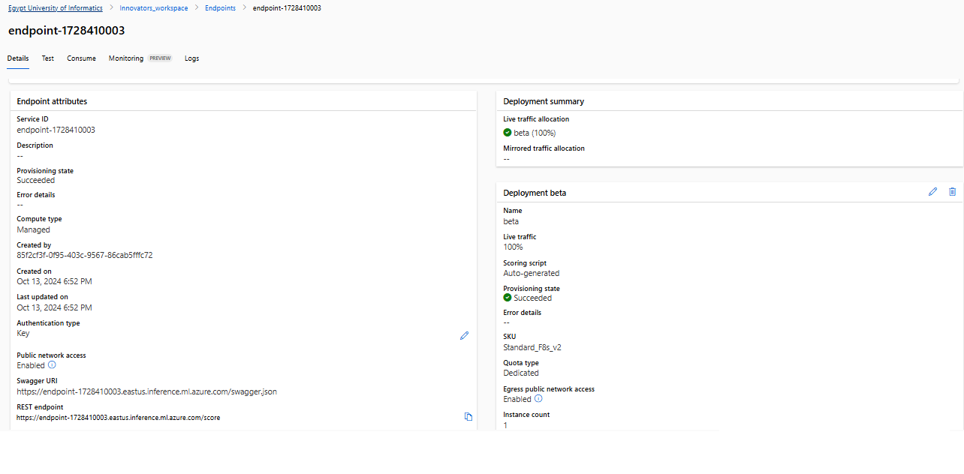
Endpoint

Slide 56
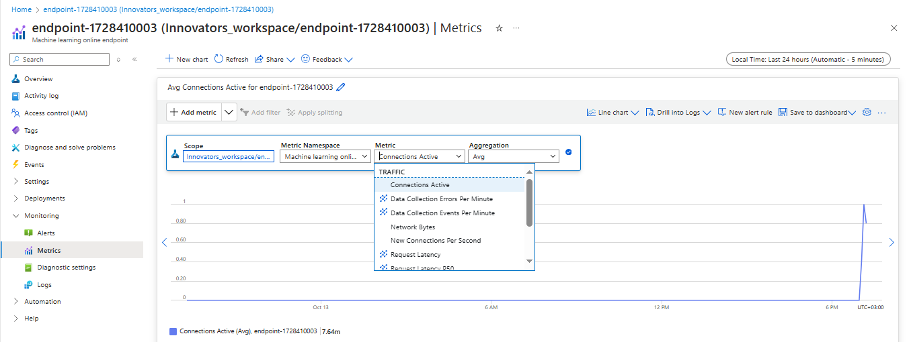
Metrics

Slide 57
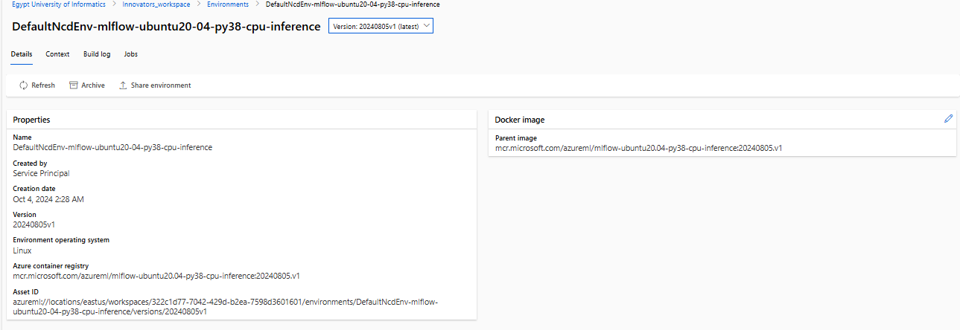
Environment

Slide 58
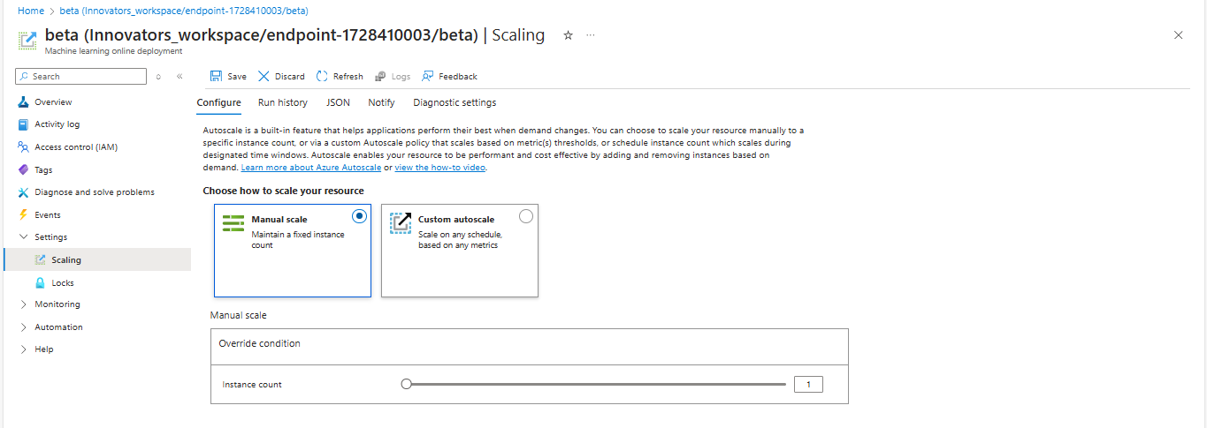
Scaling

Slide 59
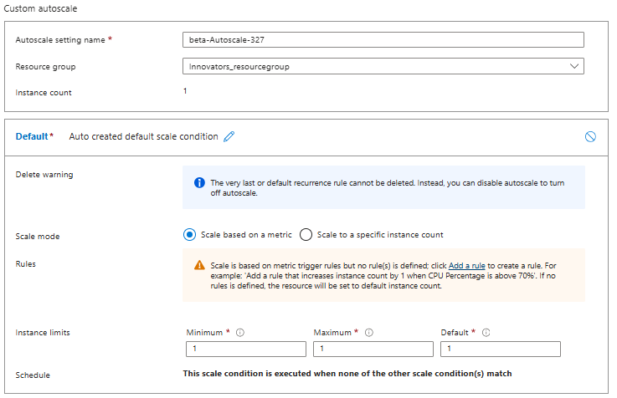
Autoscaling

Slide 60
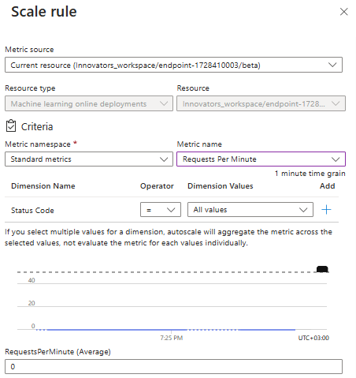
Autoscaling

Slide 61
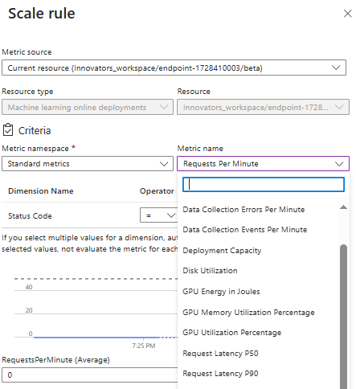
Autoscaling

Slide 62
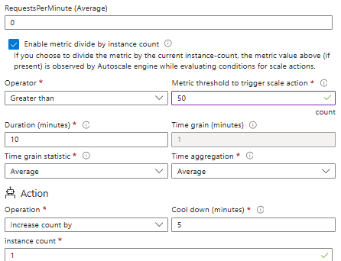
Autoscaling

Slide 63
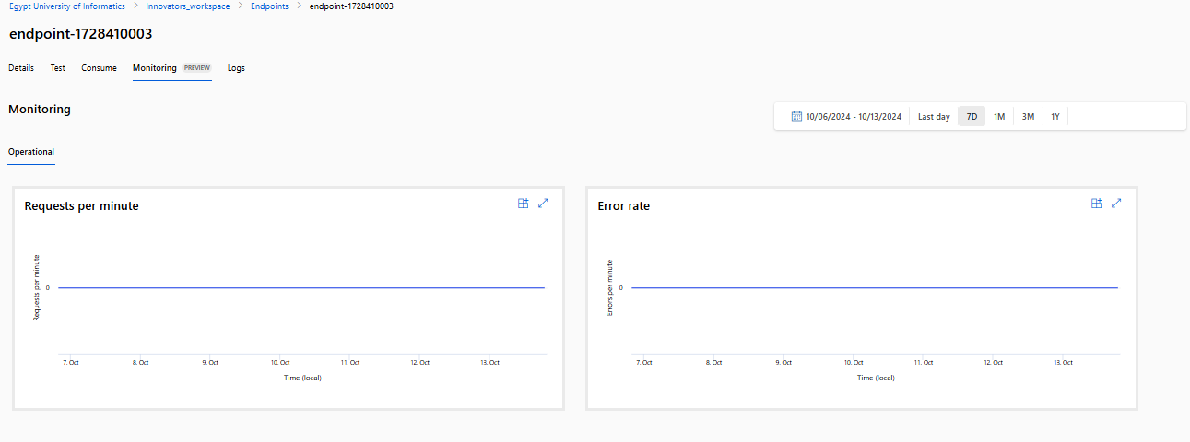
Monitoring

Slide 64
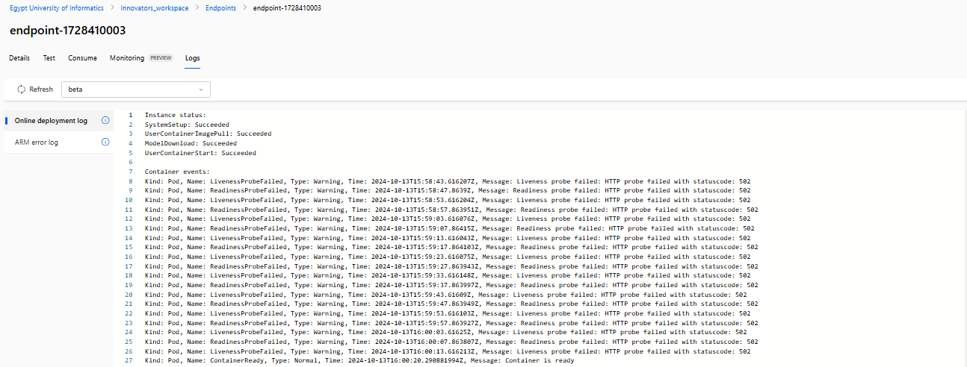
Logs

Slide 65

Streamlit Application

Slide 66

Streamlit Application

Slide 67

Streamlit Application

Slide 68
MLflow

Slide 69

MLflow

Slide 70

Experiments

Slide 71

Runs

Slide 72

Run - Model Overview

Slide 73

Run - Model Metrics

Slide 74

Run - Model Metrics

Slide 75

Run - Model Artifacts

Slide 76

Run - Model Parameters

Slide 77

Model Registry

Slide 78

Model Registry

Slide 79
Thank You

